Slide 1
Opencv-Python for Image Processing

Slide 2
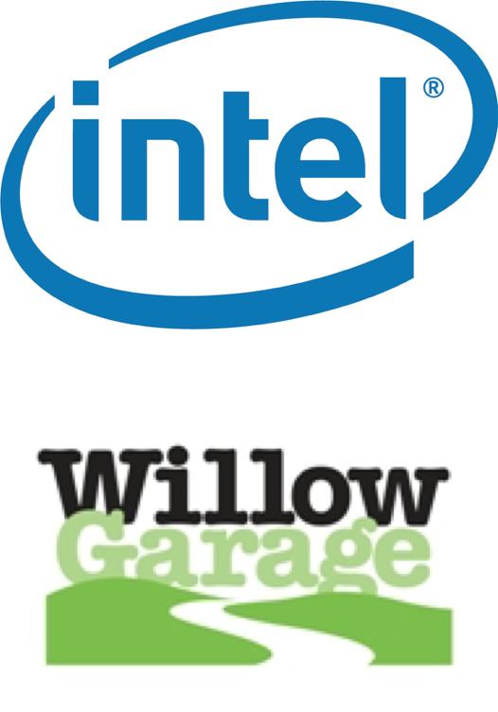
Introduction
OpenCV is an Image Processing library created by Intel and maintained by Willow Garage.
Available for C, C++, and Python
Newest update is version 2.2
Open Source and free
Easy to use and install

Slide 3
Installation
Open Computer Vision (OpenCV) library
pip install opencv-python
Numpy library
pip install numpy
Matplot library
pip install matplotlib

Slide 4
Reading an Image
Syntax: cv2.imread(path, flag)
Parameters:
path: A string representing the path of the image to be read.
flag: It specifies the way in which image should be read. It’s default value is cv2.IMREAD_COLOR
cv2.IMREAD_COLOR: flag value is 1.
cv2.IMREAD_GRAYSCALE: flag value is 0
cv2.IMREAD_UNCHANGED: flag value is -1
Return Value: This method returns an image that is loaded from the specified file.
Code:
read_img.py

Slide 5
Write an Image
Code:
write_img.py
Syntax: cv2.imwrite(filename, image)
Parameters:
filename: A string representing the file name. The filename must include image format like .jpg, .png, etc.
image: It is the image that is to be saved.
Return Value: It returns true if image is saved successfully.

Slide 6
Image Arithmetic
Addition of Image
Syntax: cv2.add(img1, img2)
Syntax: cv2.addWeighted(img1, wt1, img2, wt2, gammaValue)
Subtraction of Image
Syntax: cv2.subtract(src1, src2)
Bitwise operation: Binary image
cv2.bitwise_and(source1, source2, destination, mask)
cv2.bitwise_or(source1, source2, destination, mask)
cv2.bitwise_xor(source1, source2, destination, mask)
cv2.bitwise_not(source, destination, mask)

Slide 7
Access pixel data
Code:
access_pixel_data.py

Slide 8
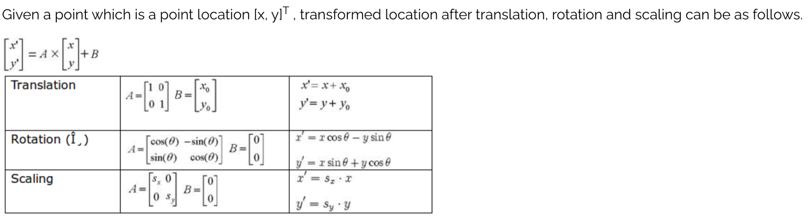
Affine transformation
An affine transformation is a geometrical transformation which moves points in space such that points which were lying on a line remain so after the transformation.

Slide 9
Resize Image
Code:
resize_img.py
Syntax: cv2.resize(source, dsize, dest, fx, fy, interpolation)
Parameters:
source: Input Image array (Single-channel, 8-bit or floating-point)
dsize: Size of the output array
dest: Output array (Similar to the dimensions and type of Input image array) [optional]
fx: Scale factor along the horizontal axis [optional]
fy: Scale factor along the vertical axis [optional]
interpolation: One of the above interpolation methods [optional] (cv2.INTER_AREA, cv2.INTER_CUBIC, cv2.INTER_LINEAR)

Slide 10
Neighbourhood operation
Average filtering
Gaussian filtering
Median filtering

Slide 11
Image transform
Negation transform
Code: negation_transform.py
Logarithm transform
Power law transform

Slide 12
Histogram analysis
Syntax: cv2.calcHist(images, channels, mask, histSize, ranges[, hist[, accumulate]])
images : it is the source image of type uint8 or float32 represented as “[img]”.
channels : it is the index of channel for which we calculate histogram. For grayscale image, its value is [0] and
color image, you can pass [0], [1] or [2] to calculate histogram of blue, green or red channel respectively.
mask : mask image. To find histogram of full image, it is given as “None”.
histSize : this represents our BIN count. For full scale, we pass [256].
ranges : this is our RANGE. Normally, it is [0,256].
Codes: hist_analysis_img.py

Slide 13
Histogram processing
Syntax: cv2.equalizeHist(img)
Code:
hist_process_img.py

